Slide 1
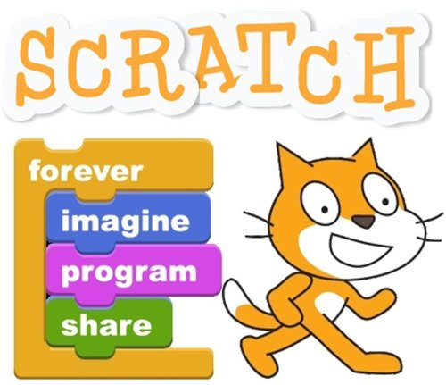
Introduction to Programming using Scratch

Slide 2
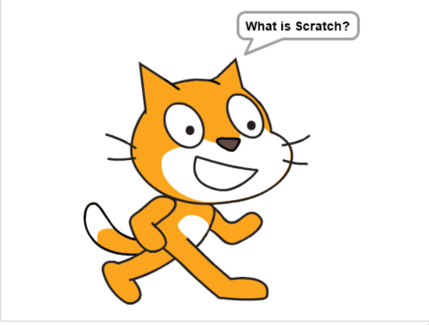

Slide 3
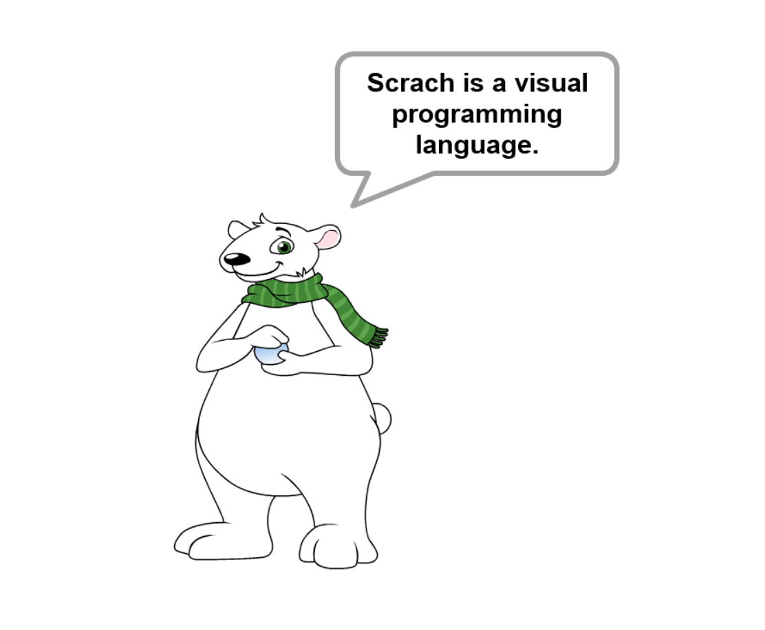

Slide 4
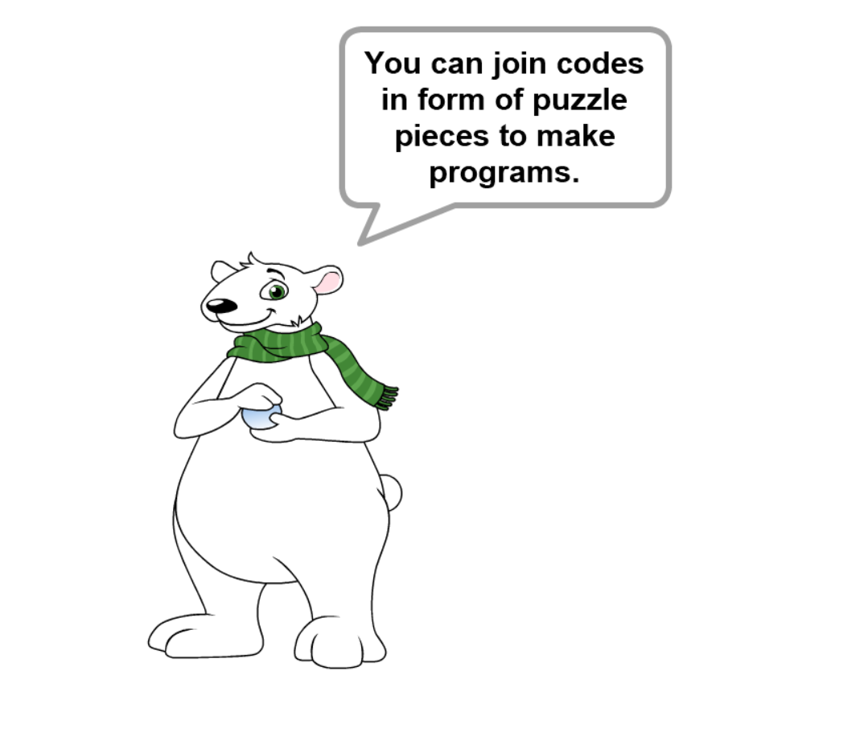

Slide 5
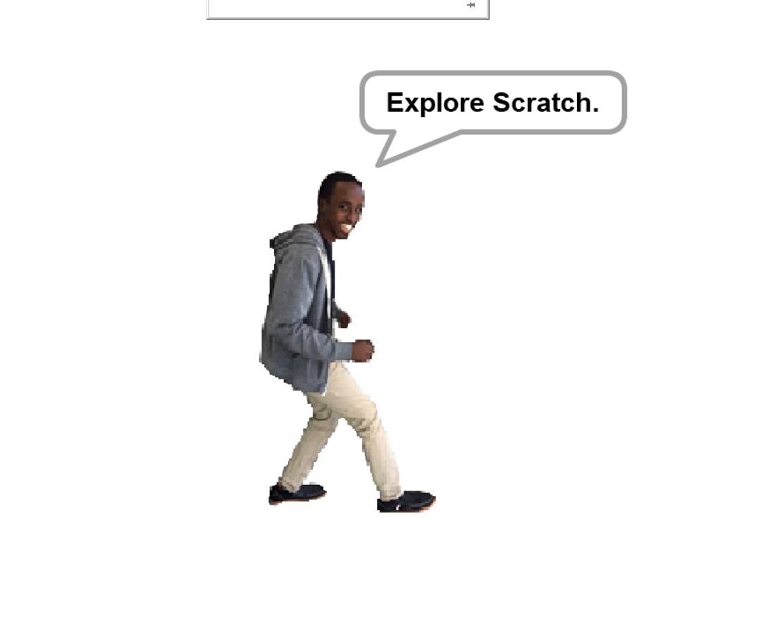

Slide 6
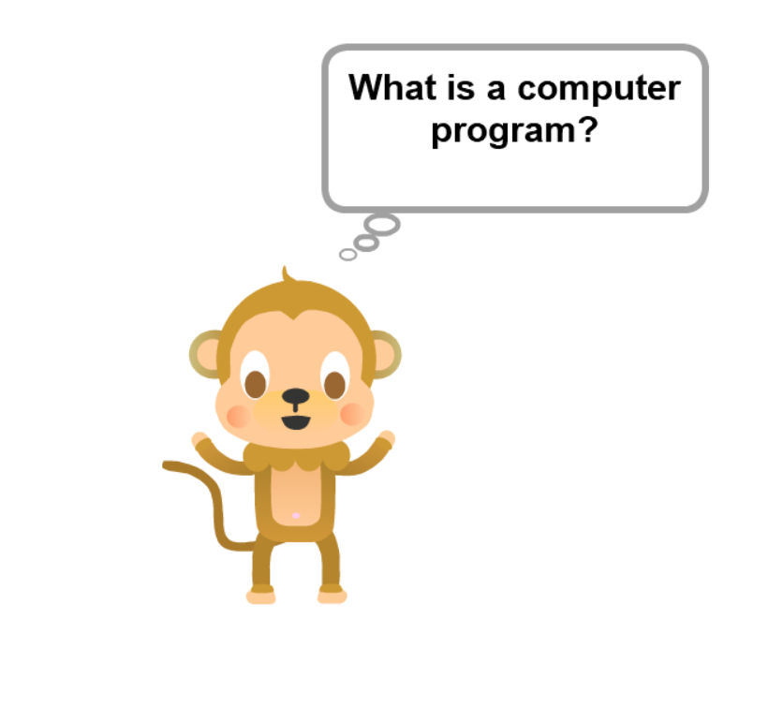

Slide 7
Structure of a program
Entry Point
Statements and Instructions
Program termination

Slide 8
Operators
+
-
*
/
% (modulo)
<
>
=
and
or
not

Slide 9
Integer
Float
Strings
Boolean (True or False)
List

Slide 10
Constants and Variables

Slide 11
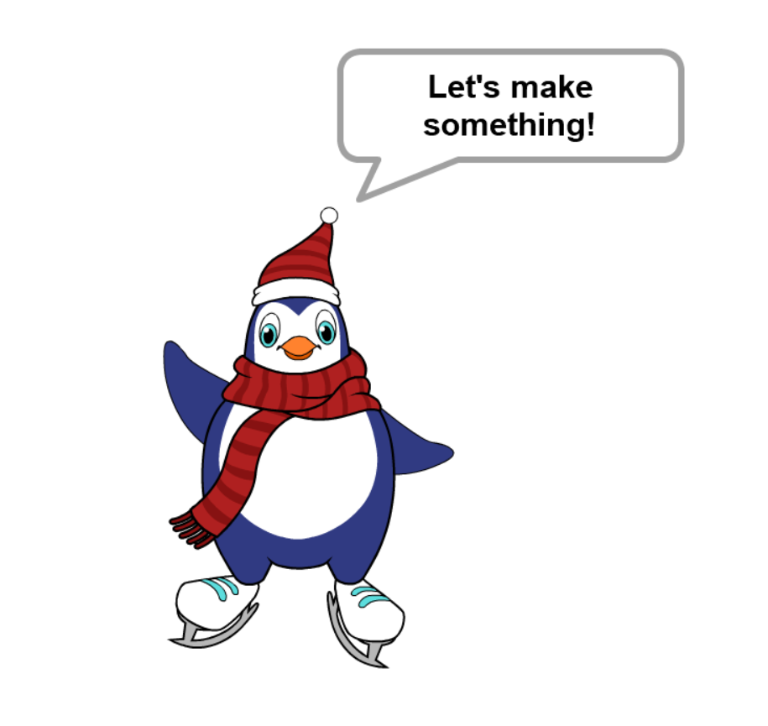

Slide 12
Conditions
if condition then
statement_true
else
statement_false

Slide 13


Slide 14
